Slide 1




Use market basket analysis to classify shopping trips
Xiuquan Zhang & Zheng Xu
September 2019

Slide 2

About the Data
A Kaggle competition and classification problem hosted by Walmart
https://www.kaggle.com/c/walmart-recruiting-trip-type-classification
Number of records - 647,054 with samples with ~ 96k store visits and 38 trip types
5 features: Weekday, UPC, Scan Count, Department Description, and Fineline Number
Multi-class log loss (cross entropy) was used to evaluate the performance of predicted probabilities.
N: number of visits in the test set
M: number of trip types
y_{ij}: 1 if observation i is of class j and 0 otherwise
p_{ij}: predicted probability that observation i is of class j

Slide 3
About the Data
Feature | Feature Description | Unique Value
TripType | A categorical id representing the type of shopping trip the customer made. | 38
VisitNumber | An id corresponding to a single trip by a single customer. | 95674
Weekday | The weekday of the trip | 7
Upc | The UPC number of the product purchased. | 97715
ScanCount | The number of the given item that was purchased. A negative value indicates a product return. | 39
DepartmentDescription | A high-level description of the item's department. | 69
FinelineNumber | A more refined category for each of the products, created by Walmart. | 5196

Slide 4
Issues and Challenges with the Data
Each observation represented an item rather than a visit.
Needed to group observations by visit to classify the trip.
Uneven Distribution of TripType.
Records with incomplete values, however many of them do contain some information.
Dummy variables (Categorical) - Weekday; Converted qualitative values to quantitative. Eg: Monday =1, Tuesday =2.
Duplicate department labels. Eg: “MENSWEAR” and“MENS WEAR”.
Number of unique UPCs and Fineline Numbers are large and without direct meanings, either need to select the top most frequent UPC and Fineline number categories and decoding are required.

Slide 5
General Workflow
Data Analysis
Feature Engineering
Modeling
Uncovering the classification strategy
Trip type statistics and visualization (histogram, heat map etc.)
Feature selection
Remove missing values
Separate numerical & categorical
Converting categorical data to numerical
Data grouping & transforming
Choosing algorithm
Setting Parameters
Training models
Hyper parameters tuning with randomized search CV
Compare results

Slide 6
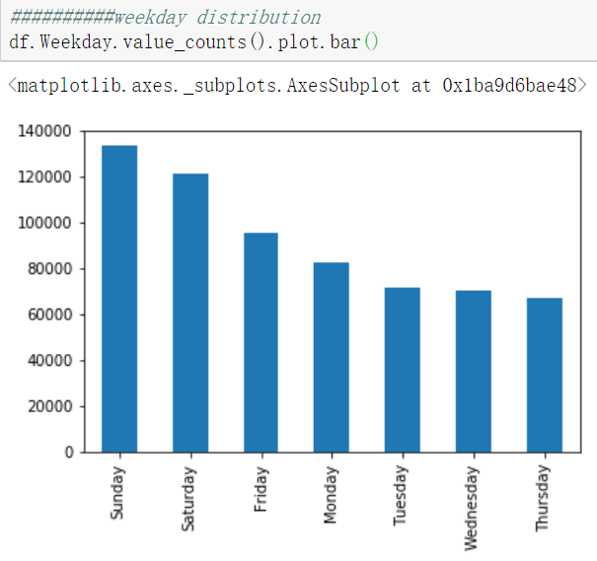
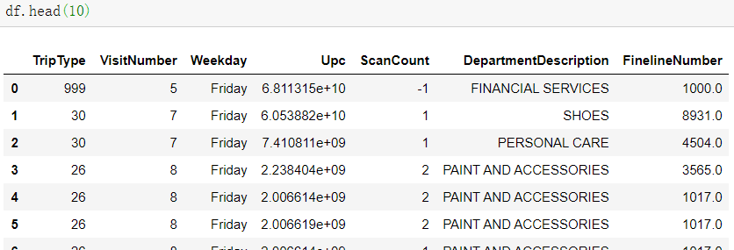
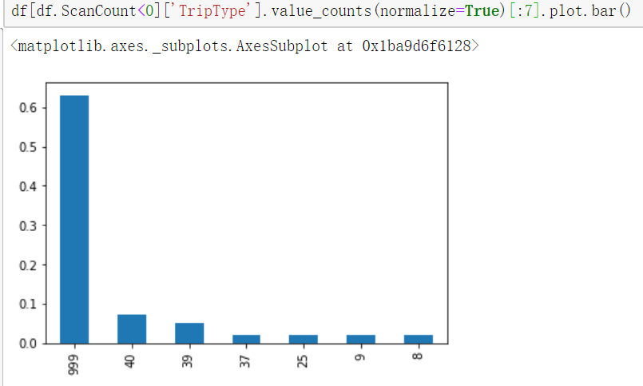
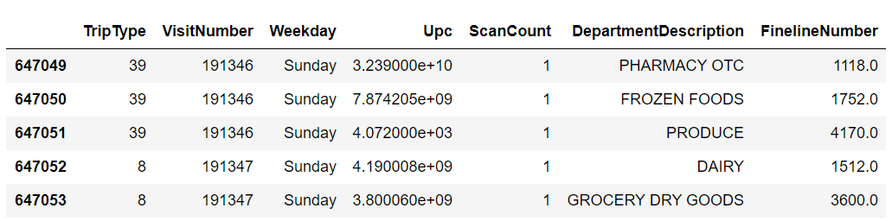
weekday or weekend
Data Analysis
94247
68
5195
When ScanCount < 0

Slide 7
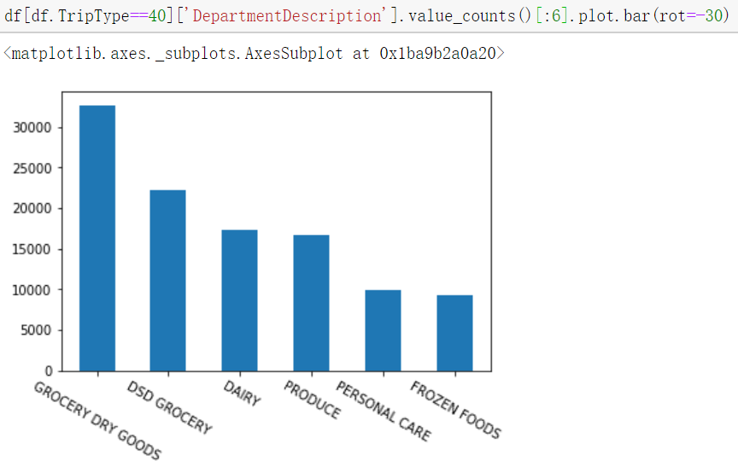
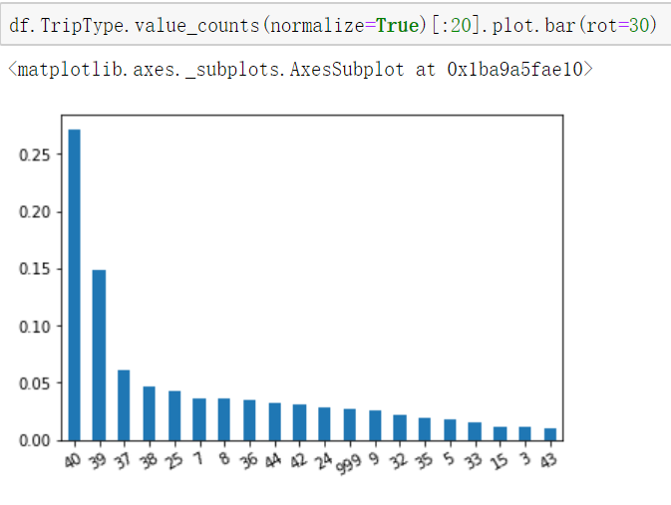
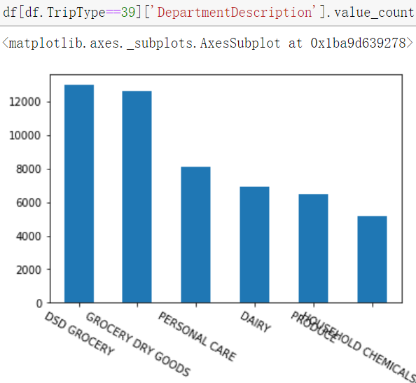
Data Analysis
TripType:40
TripType:39
50%
…

Slide 8
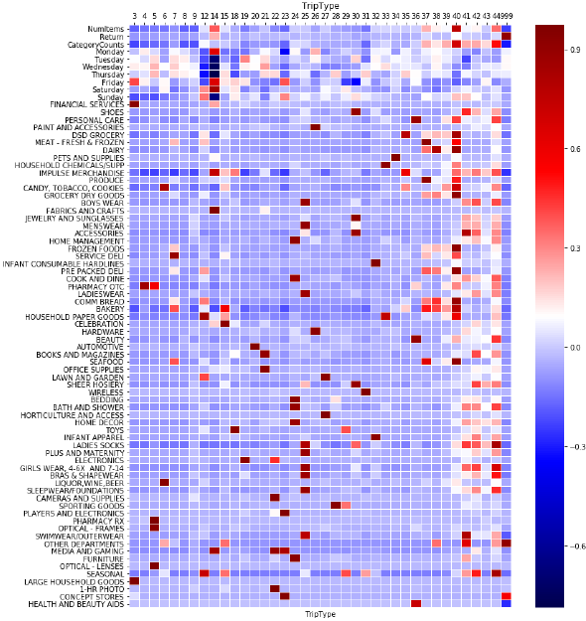
Data Analysis
Heat map shows the distribution of different trip types based on categories
The darker the red colour is, the higher the correlation
For example, TripType 999 is mostly associated with return, other departments and concept stores

Slide 9
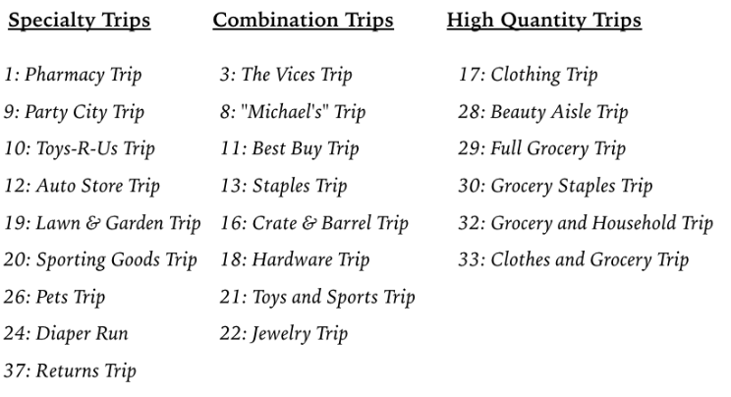
Trip Type | Top Categories | assumption
40 | GROCERY DRY GOODS DSD GROCERY, DAIRY, PRODUCE | GROCERY
39 | DSD GROCERY, GROCERY DRY GOODS | GROCERY
37 | PRODUCE | Produce
38 | DAIRY, GROCERY DRY GOODS | GROCERY
25 | MENS WEAR, LADIESWEAR, GIRLS WEAR | CLOTHING
7 | SERVICE DELIVERY | DELIVERY
8 | DSD GROCERY, PERSONAL CARE | PERSONAL CARE
36 | PERSONAL CARE, BEAUTY | PERSONALCARE
44 | PERSONAL CARE, DSD GROCERY | PERSONAL CARE
42 | IMPULSE MERCHANDISE, CELEBRATION | IMPULSE
24 | COOK AND DINE, HOME MANAGEMENT | HOME DEPOT
999 | FINANCIAL SERVICES, IMPULSE MERCHANDISE | FINANCIAL
9 | MENS WEAR, IMPULSE MERCHANDISE,AUTO | MEN
32 | INFANT CONSUMABLE HARDLINES/APPAREL | INFANT

Slide 10
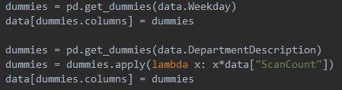

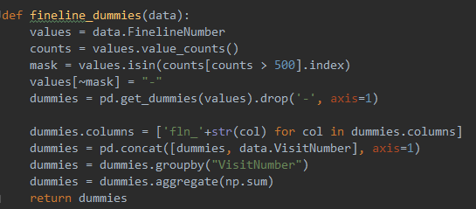
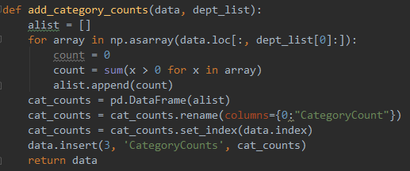
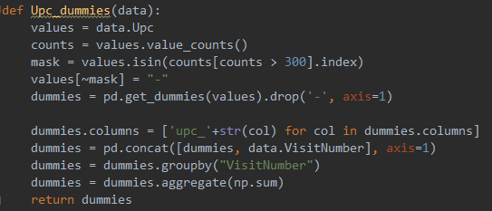
Feature Engineering
Num Items | Return | Category Counts | Day of week | Category | Fineline number | UPC number

Slide 11
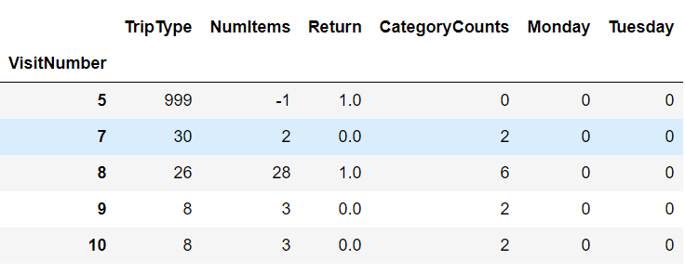
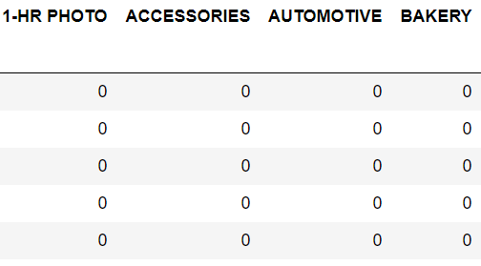
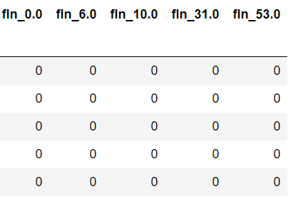
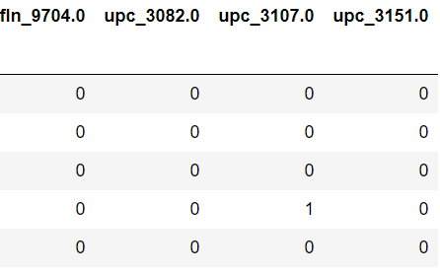

Feature Engineering
Trip Type (Label)
Num Items | Return | Category Counts | Day of week | Category | Fineline number | UPC number
Label
…
…
…

Slide 12
Machine Learning Models Used
Ensemble Methods:
Random Forest Classifier
Extreme Gradient Boost Classifier (XGBoost)
Neural Networks:
Keras classifiers with 1, 2, 3 and 4 hidden layers
Stacking Classifiers:
Neural networks as both the first-level classifiers and meta-classifier
Neural networks based stacking with multinomial logistic regression as meta-classifier
Neural networks based stacking with XGBoost as meta-classifier

Slide 13
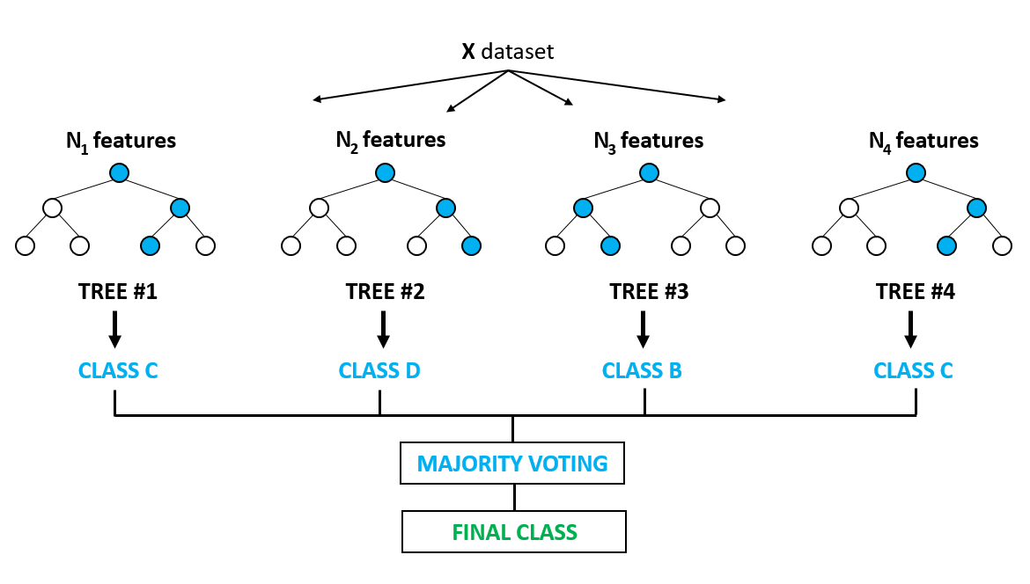
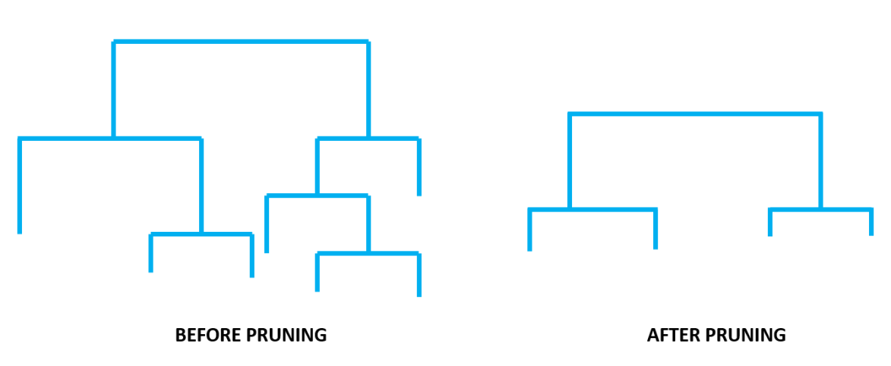
Random Forest Classifier
It is a collection of decision trees.
Classification done by a 'majority vote' of the decision trees within the random forest.
By combining the predictions made by each individual tree, it decreases variance and gives good performance.
Notes:
Classification done by a 'majority vote' of the decision trees within the random forest. That is, for a given observation the class that is most frequently predicted within the random forest will be the class label for that observation.
https://www.globalsoftwaresupport.com/random-forest-classifier-bagging-machine-learning/

Slide 14
Random Forest Classifier
Hyperparameters tuning using RandomizedSearchCV
Parameters | Meaning | Tuning Values | Selected Value
n_estimators | number of trees in the forest | N/A, set as 50 | 200
max_depth | maximum depth of the tree | [50, 60, 70, 80] | 80
min_samples_split | minimum number of samples required to split an internal node | [3, 5, 7] | 6
min_samples_leaf | minimum number of samples required to be at a leaf node | [2, 4] | 2
max_features | number of features to consider when looking for the best split | ['sqrt', 'log2'] | 'sqrt'
bootstrap | Whether bootstrap samples are used when building trees | [True, False] | False
Accuracy: 0.695769 / Log Loss: 1.022597
Notes:
Reduces overfitting by pruning and bagging.

Slide 15
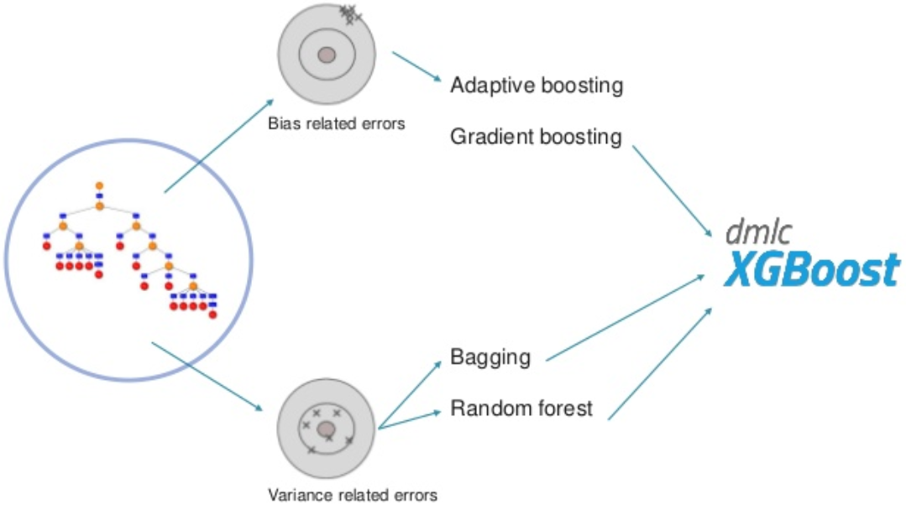
Extreme Gradient Boost Classifier (XGBoost)
XGBoost implements a Gradient Boosting algorithm based on an ensemble of decision trees.
Unlike Random Forest builds fully grown decision trees in parallel on subsamples of the data, XGBoost builds short and simple decision trees iteratively.
Each tree is a “weak learner” for their high bias.
It sequentially builds more weak learners, each one correcting the previous tree until a stopping condition is reached.
Notes:
https://blog.cambridgespark.com/getting-started-with-xgboost-3ba1488bb7d4

Slide 16
Extreme Gradient Boost Classifier (XGBoost)
Hyperparameters tuning using RandomizedSearchCV
Parameters | Meaning | Tuning Values | Selected Value
n_estimators | number of trees in the xgb | N/A, set as 50 | 100
max_depth | maximum depth of the tree | [5, 7, 9, 11] | 11
min_child_weight | minimum sum of instance weight(hessian) needed in a child | [1, 5, 10] | 5
gamma | minimum loss reduction required to make a further partition on a leaf node of the tree | [0, 2, 4, 6, 8] | 4
subsample | subsample ratio of the training instance | [0.6, 0.8, 1.0] | 0.6
colsample_bytree | subsample ratio of columns when constructing each tree | [0.6, 0.8, 1.0] | 0.6
Accuracy: 0.683226 / Log Loss: 1.023998, it only uses the old feature engineering which did not include UPC and fineline numbers.

Slide 17
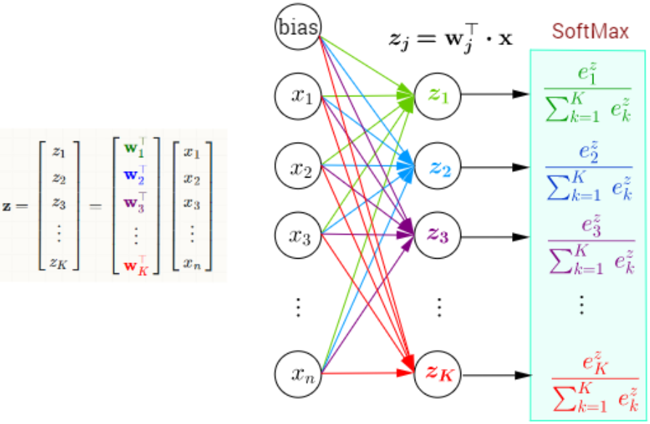
Neural Networks
Define model hypothesis:
Number of layers and neurons per layer
Activation function: ReLU for hidden layers and softmax for output
Dropout rate
Cost function: Logloss for classification
Optimize defined cost function by gradient descent (or variants)
Back propagate errors from output to all hidden layers
Notes:
WE don’t need to initialize W and b in Keras

Slide 18
Neural Networks
Tuned the batch size, and both the number of nodes and dropout rate of each hidden layer for networks with 1 and 2 hidden layers
Code snippet:
create_model_NN_1HiddenLayer(input_dim, nodes_l1=512, dropout_l1=0.3)
create_model_NN_2HiddenLayers(input_dim, nodes_l1=400, nodes_l2=120, dropout_l1=0.3, dropout_l2=0.2)
create_model_NN_3HiddenLayers(input_dim, nodes_l1=500, nodes_l2=200, nodes_l3=80, dropout_l1=0.3, dropout_l2=0.2, dropout_l3=0.2)
create_model_NN_4HiddenLayers(input_dim, nodes_l1=512, nodes_l2=256, nodes_l3=128, nodes_l4=64, dropout_l1=0.3, dropout_l2=0.3, dropout_l3=0.2, dropout_l4=0.2)
if model_tune == 'NN_1HiddenLayer_RS':
nodes1 = np.arange(350, 600, 50)
dropout1 = np.arange(0.1, 0.5, 0.1)
if model_tune == 'NN_2HiddenLayers_RS':
nodes1 = np.arange(350, 550, 50)
nodes2 = np.arange(100, 350, 50)
dropout1 = np.arange(0.1, 0.5, 0.1)
dropout2 = np.arange(0.1, 0.5, 0.1)

Slide 19
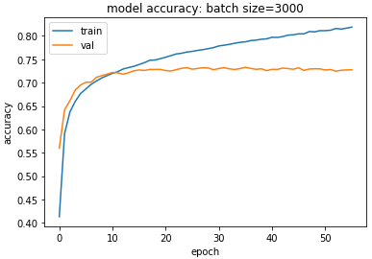
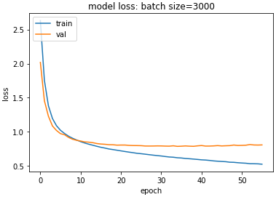
Neural Networks
Scores based on accuracy using only default values:
1 Hidden Layer:
val_loss: 0.7899, val_acc: 0.7329
2 Hidden Layers:
val_loss: 0.7912, val_acc: 0.7324
3 Hidden Layers:
val_loss: 0.8023, val_acc: 0.7344
4 Hidden Layers:
val_loss: 0.8378, val_acc: 0.7339

Slide 20
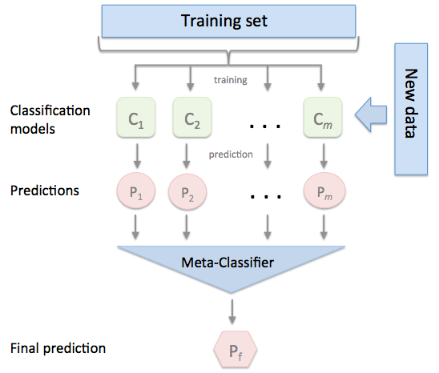
Stacking Classifier
An ensemble learning technique to combine multiple classification models via a meta-classifier.
The individual classification models are trained based on the complete training set
Meta-classifier fitted based on the outputs of the individual classification models in the ensemble.
Meta-classifier can either be trained on the predicted class labels or probabilities from the ensemble.
Notes:
http://rasbt.github.io/mlxtend/user_guide/classifier/StackingClassifier/
Talk about tuning strategies

Slide 21
Stacking Classifier
Neural networks as both the first-level classifiers and meta-classifier
Code snippet:
def NN_Stacking(X_train, X_test, y_train, y_test):
clf1 = KerasClassifier(build_fn=create_model_NN_1HiddenLayer, input_dim=38*4, epochs=30, batch_size=1000, verbose=2)
clf2 = KerasClassifier(build_fn=create_model_NN_2HiddenLayers, input_dim=input_dim, epochs=15, batch_size=1000, verbose=2)
clf3 = KerasClassifier(build_fn=create_model_NN_3HiddenLayers, input_dim=input_dim, epochs=15, batch_size=1000, verbose=2)
clf4 = KerasClassifier(build_fn=create_model_NN_4HiddenLayers, input_dim=input_dim, epochs=15, batch_size=1000, verbose=2)
sclf = StackingClassifier(classifiers=[clf2, clf2, clf3, clf4], use_probas=True, average_probas=False, meta_classifier=clf1)
Accuracy: 0.73243, Log Loss: 0.91964

Slide 22
Stacking Classifier
Neural networks based stacking with multinomial logistic regression as meta-classifier
Code snippet:
def NN_Stacking_with_LR(X_train, X_test, y_train, y_test):
input_dim = len(X_train.columns)
clf1 = KerasClassifier(build_fn=create_model_NN_1HiddenLayer, input_dim=input_dim, epochs=30, batch_size=1000, verbose=2)
clf2 = KerasClassifier(build_fn=create_model_NN_2HiddenLayers, input_dim=input_dim, epochs=15, batch_size=1000, verbose=2)
clf3 = KerasClassifier(build_fn=create_model_NN_3HiddenLayers, input_dim=input_dim, epochs=15, batch_size=1000, verbose=2)
clf4 = KerasClassifier(build_fn=create_model_NN_4HiddenLayers, input_dim=input_dim, epochs=15, batch_size=1000, verbose=2)
lr = LogisticRegression(C=0.4, solver='lbfgs', multi_class='multinomial', random_state=42)
sclf = StackingClassifier(classifiers=[clf1, clf2, clf3, clf4], use_probas=True, average_probas=False, meta_classifier=lr)
Accuracy: 0.73285, Log Loss: 0.97098
Notes:
Can use any models as the first level classifiers, and

Slide 23
Stacking Classifier
Neural networks based stacking with XGBoost as meta-classifier
Code snippet:
def NN_Stacking_with_XGB(X_train, X_test, y_train, y_test):
input_dim = len(X_train.columns)
clf1 = KerasClassifier(build_fn=create_model_NN_1HiddenLayer, input_dim=input_dim, epochs=30, batch_size=1000, verbose=2)
clf2 = KerasClassifier(build_fn=create_model_NN_2HiddenLayers, input_dim=input_dim, epochs=15, batch_size=1000, verbose=2)
clf3 = KerasClassifier(build_fn=create_model_NN_3HiddenLayers, input_dim=input_dim, epochs=15, batch_size=1000, verbose=2)
clf4 = KerasClassifier(build_fn=create_model_NN_4HiddenLayers, input_dim=input_dim, epochs=15, batch_size=1000, verbose=2)
xgbc = XGBClassifier(n_estimators=100, min_samples_split=5, min_samples_leaf=2, max_features='sqrt',
max_depth=50, bootstrap=False, random_state=42)
Accuracy: 0.72616, Log Loss: 1.10945

Slide 24
Summary and Conclusions
So far, the stacking classifiers with neural networks gave the best accuracy performance, but other combinations of classifiers can also be experimented
Gradient or randomized search for hyperparameters tuning can be time consuming especially without GPU, it may be better to invest more time in better feature engineering instead and could have more improvement than selecting the best machine learning models

Slide 25
Notes:
Neural networks based stacking with multinomial logistic regression as meta-classifier
Neural networks based stacking with XGBoost as meta-classifier

